Slide 1
Practical (Hands On) Lesson – Formatting: Font, Styles , Size ,Color, Highlight, Effects

Slide 2
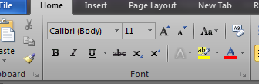
Font type , Style , size , colour
Fonts
You can play with fonts in many ways. You can change text’s font colour, style, background colour etc.
Change your font to Bold, Italic or Underline the text in your document.
The whole list of fonts options are located under the Font section in the Home menu

Slide 3


Changing the colour of the text

Slide 4
How to apply styles
Select that area and click the Home menu
Built-in styles in the Styles section are available.
Choose a suitable Style

Slide 5


Slide 6
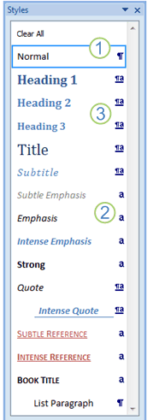
The Styles task pane
then opens :

Slide 7
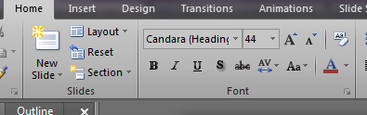
Text Effects :
In the Home Tab , Font Group

Slide 8
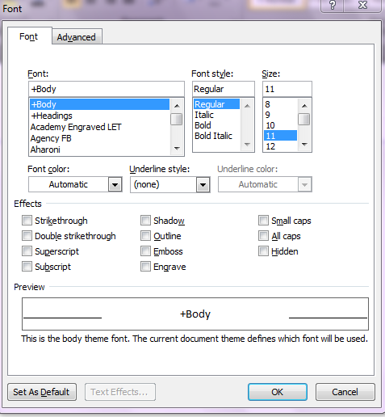
Choose your option

Slide 9

Activity in Data_Solutions folder
Change text effects

Slide 10
Images taken from Google images
Screenshots taken of Word Window
office.microsoft.com

